Slide 1
Super Resolution Using GANs
15EC401M-Multidiciplinary Design Proposal
Satyam Rout - RA1711004010411
Divya Gupta - Ra1711004010427

Slide 2
Introduction
Multuimedia c0mponents like images, videos, graphics etc play a vital role in our daily lives .
We use augmented videos/images from various resourses such as webpages/youtube etc for purposes like learning, entertainment and many more .
So this augmented images/videos are processed in order to make it computer understandable. Due to which, its property gets degraded due to addition of various noises or loss of pixels.
As a result we are unable to get proper images/videos. So we use various computer applications to enhance the video/image qualities, Which requires some pre-requisites.

Slide 3
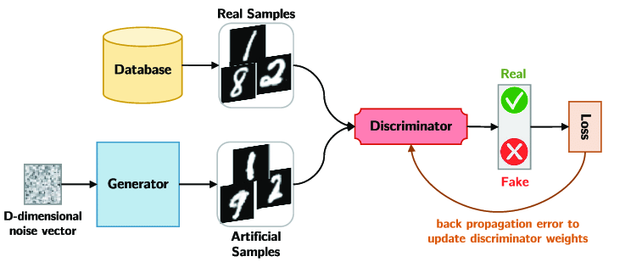
Introduction
So in order to overcome this, researchers have come up with an AI solution, which can regenerate the blurred/distorted images.
They proposed Generative Adversiaral Networks.
As the name suggests it is a Deep learning framework which can regenerate images similar to that of the given one.
GANs have also proven useful for Supervised and Reinforcement learning.
Architecture

Slide 4
About the proposal
In this proposal we aim to create super-resolution images and videos from the blurred low end images/videos.
The high Dpi images such as satellite images and long range images which cannot be distinguished by human eyes can also be viewed clearly with the help of this AI based approach.
In this approach the ditorted images/videos are fed through neural networks inorder to get super resolution images.
This proposal is then further extended to creation of fast video streaming even in low bandwidth of internet, by applying the SRGAN in the backend to get a regenerated super resolution video streaming.

Slide 5
About the proposal
While training, the high resolution(HR) images are downsampled to low resolution(LR) images and then upsampled to super resolution(SR) images when passed through generator and then we use the discriminator to distinguish the HR images and backpropagate the GAN loss to train the generator and discriminator further, until the discriminator gets fooled by the generator and is unable to distinguish between the original and the generated image.
HR
X
D(X)
LR
Generator
Discriminator
GAN loss
SR

Slide 6
Multidiciplinary components
Python modules/Apis | Description
Pillow/OpenCV | This libraries are used for image-processing
Numpy | Library is used for complex matrix calculations
Pandas | Library used for dining various analysis of the features of the data
Scikit-learn | This is most used library for various machine learning algorithms
Keras | This is a High level Api solely used for deep learning applications.
Tensorflow | An Api by google developed using C++.

Slide 7
Literature Survey
There have been many researches done for the high resolution of static images but there are very few in the case of videos as compared to images , video contain additional temporal dynamics .
There arises computational and storage problems with video based algorithms. In videos , due to action recognition problem, the static images are not sufficient for prediction even if the best frame is chosen[2].
There are various ways found in which this can be done using generative models such as autoencoders, autoregressive models and generative adverserial networks(GANs) [1].
The major issue that GAN suffered all these years was its instability while trainning and failure to converge, this has been greately improved with the help of more developed loss functions,architecture and trainning models.
While designing models for generation of vedios we need to consider the spatial as well as the temporal aspects of the vedio which infer the objects and the dynamics of the objects respectively.

Slide 8
Literature Survey
One of the methods to do this is to demonstrate the spatio-temporal coherence which supervises the short-term temporal coherence and self-supervision for long term temporal coherence[3].
For adverserial training, we use two networks namely the generator and the discriminator.
The loss function is designed so that generator’s goal is to generate samples that fool the discriminator.
The discriminator tries to distinguish whether the generated sample is from a given distribution or not. The discriminator’s goal is designed to avoid being fooled by the generator.

Slide 9
Literature Survey
For spatio-temporal adverserial trainning the output of the generator is again fed into the generator as input so as to use the input as well as the previous generated output of the generator this improves the perceptual quality[3.].
The frame triplets provides the network with gradient information regarding the realism of spatial structures as well as short-term temporal information, such as first and second-order time derivatives.

Slide 10
Literature Survey
In early years, discriminators were trained with sigmoid cross entropy loss as they were trained as classifiers for real and generated data. However, this led to vanishing gradient problem.
For this least sqaure GANs which uses least sqaure loss was proposed[4.]. This too had problems related to lack of convergence.
To reduce this the Wasserstein GAN also known as WGAN was introduced .It is an extension of the GAN that seeks an alternate way of training the generator model to better approximate the distribution of data observed in a given training dataset.
Instead of using a discriminator to classify or predict the probability of generated images as being real or fake, the WGAN changes or replaces the discriminator model with a critic that scores the realness or fakeness of a given image.
Similarly, another loss function which has proved to be useful is the ping-pong loss function. It is a linear loss function which is used in Self-Supervision for Long-term Temporal Consistency . The main pupose behind using this is to reduce the computational complexity of the neural network while find out the loss.

Slide 11
Literature Survey
The original size of the video is 64X64 which has been upscaled upto 256X256 in the previous researches[1].
There are various adverserial networks implemented until now, some of which are ENet, DsOnly, DsDt, DsDt+PP, TecoGAN⊝and TecoGAN.

Slide 12
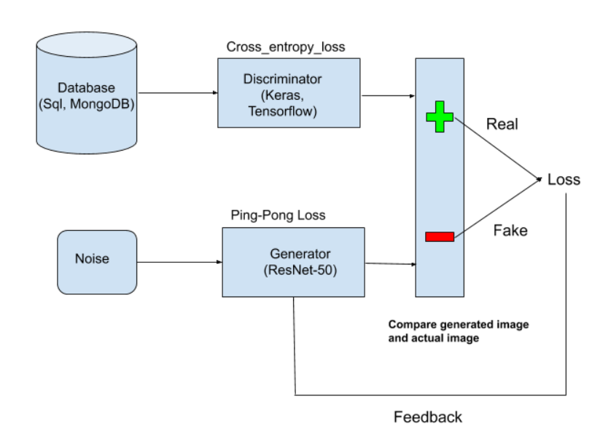
Model Design

Slide 13
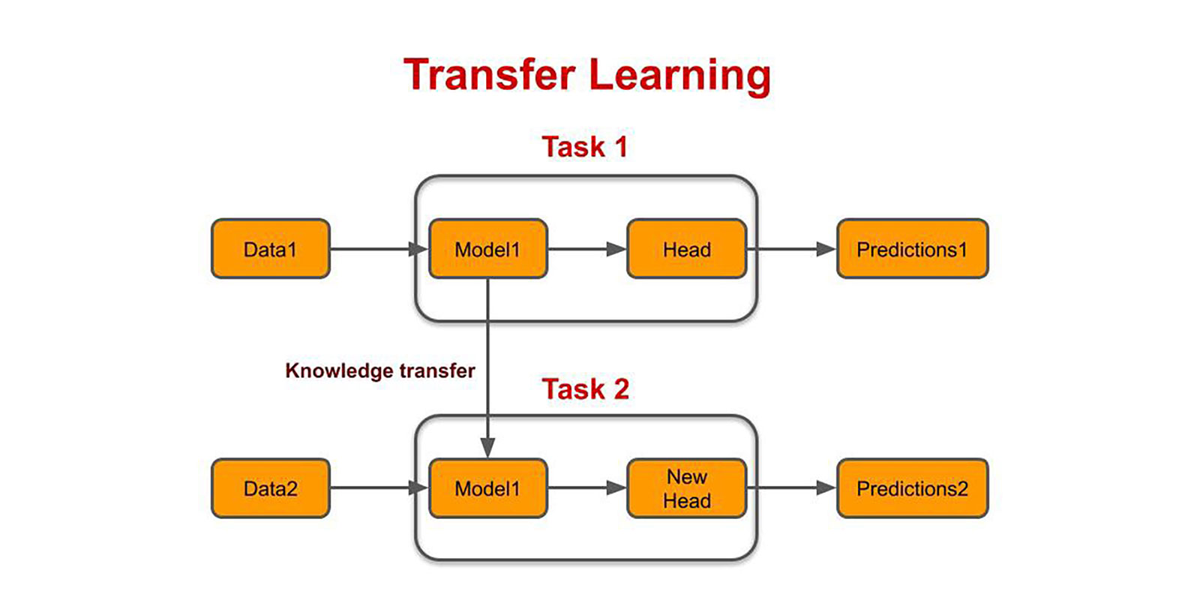
Objective
Our main objective is to upscale the 64X64 video to 320X320
The main constrain in generating high resolution is generating smooth video which is only possible if the computation time and complexity is decreased.
Here, we are going to use linear loss function instead of non linear loss function. To achieve accurate prediction results only usage of linear loss functions is not enough as vanishing gradient problems will arise.
For this we are going to use Tranfer learning . A pretrained model which is smaller in size as compared to that of the original dataset is used so as to get better prediction.

Slide 14
Objective
Ping-pong loss function:Here we consider two sequences one in forward direction and other in counter direction like (x₁ ,......., x_{t-1} , x_{t} , x_{t+1} , ....... ,x_{n}) and (x_{n} ,.......,x_{t+1},x_{t}, x_{t-1} , ......., x₁) considering the fact that the generated frame g_{t} is identical irrespective of the order of the sequence .
Forward result g_{t}=G(x_{t},g_{t-1}) Reverse result g_{t}'=G(xt,g'_{t+1})
L_{pp} = ||g₁-g₁'||₂ + ||g₂-g₂'||₂ + ...................... + ||g_{n-1} - g'_{n-1}||₂

Slide 15
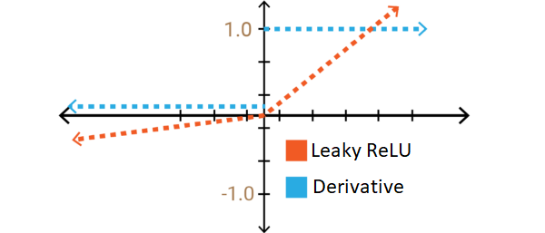
Objective
The activation function we are going to use is Leaky ReLU function or LReLU
The equation of ReLU function is represented as :
where, α is a learnable parameter.

Slide 16
Objective
The optimizer used here will be RMSProp optimizer also known as adaptive Moment Estimation.
The equation of the above optimization function is:
where w represents the weight and the value of ε is 10⁻⁸.
The L2 loss function also known as least squared error loss function is represented as:

Slide 17
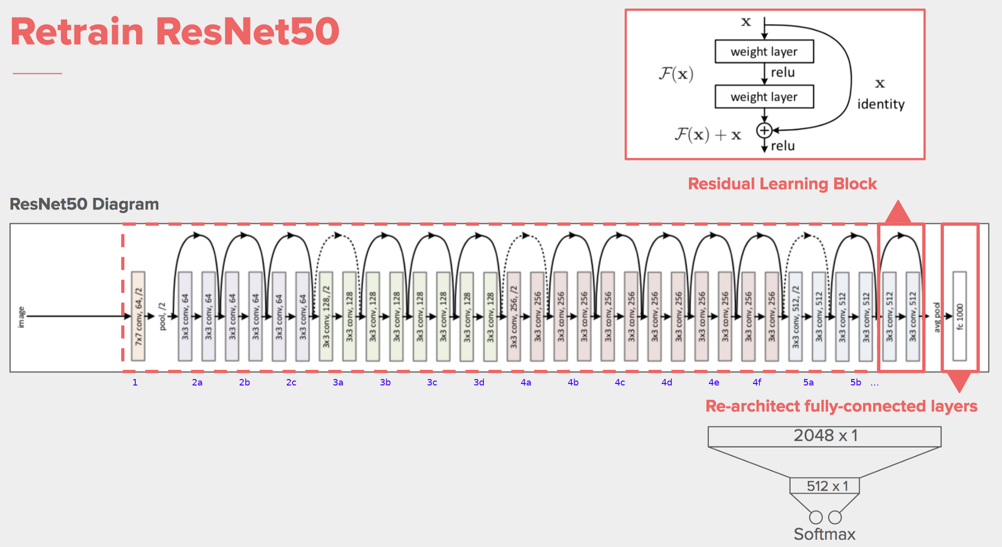
Objective
The architectural used here will be ResNet-50 convolutional neural network.

Slide 18
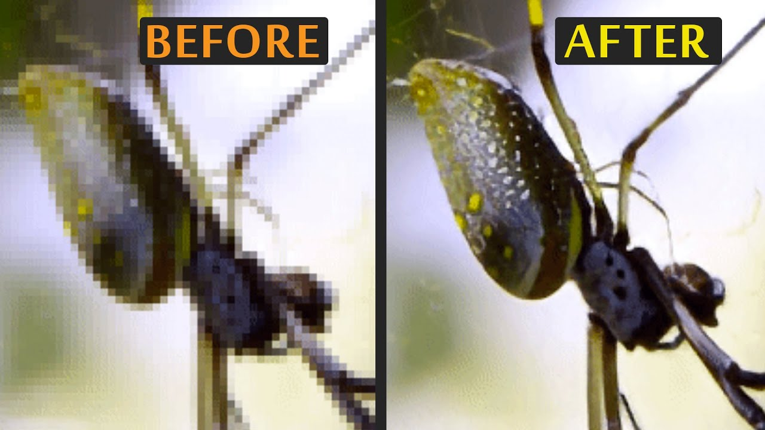
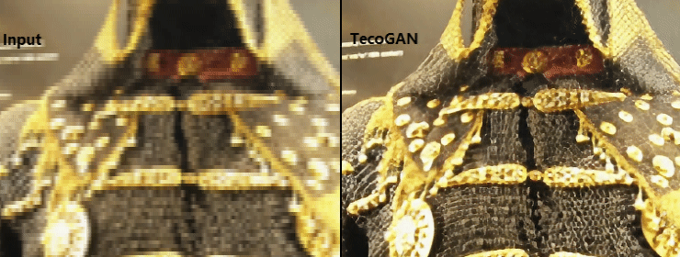
Objective
Using two discriminators requires 70% more GPU memory, and leads to a reduced training performance by 20%.
The TecoGAN⊝model yields similar perceptual and temporal quality with a significantly faster and more stable training
Since the TecoGAN⊝model requires less training resources, we can also train a generator with 50% more weights.

Slide 19
Software requirements and cost modelling
Softwares used:
1.Python (its various modules)
2.AWS EC2 instance cloud platform
3.GPU/TPU based system(for model creation)
Cost modelling:
1.GPU/TPU system from AWS(p3.16xlarge with V100 tensor GPU) - $8.39/hour

Slide 20
Realistic constraints
Requires high computational resources for model creation.
Minimum 12-core GPUs required for compilation of the model
Heavy weight model usage for better accuracy
May over generate the images i.e, overfitting problem
Make the images blurry due to more Dpi compression
Requires resources having prior knowledge of building models in case of system crash.
May generate wrong textures in the images which can lead to some other images than original one.
Some Latency will be present if run in the backend of a live video streaming.
May over-sharpen the images/videos.

Slide 21
Deliverables
This can be deployed in mobile scanning applications such as cam-scanner for super resolution of blurry images.
Can be used for security purposes like security surveillance for monitoring the crime scenes which are not visible by normal cameras.
Can be used to modify the normal camera videos for clearer footages in night or darker areas, instead of using night-vision cameras.
This proposal can be used to replace costly optical cameras.
This can be deployed in military drones for surveillance
This can also be used in various manufacturing industries for tracking the machines and its complete mechanisms.
Can be used for studying the high Dpi satellite and underwater images.

Slide 22
Conclusion
In this project we have implemented super resolution of images with the help of Generative Adversarial Networks(GANs). We have gained knowledge related to hyperparameter tuning. We have used hit and trial method for pre-trained model and weights. This proposal is implemented by taking previous research paper into account. This model can be futher improved and optimized for better results.

Slide 23
References
[1] Dinesh Acharya. Towards High Resolution Video Generation with Progressive Growing of Sliced Wasserstein GANs. arXiv:1810.02419v2 [cs.CV] 6 Dec 2018.
[2] Boris Kovalenko. Super resolution with Generative Adversarial Networks. SUID 06201315.
[3] MENGYU CHU, YOU XIE , JONAS MAYER, LAURA LEAL-TAIXÉ, and NILS THUEREY. Learning Temporal Coherence via Self-Supervision for GAN-based Video Generation. arXiv:1811.09393v4 [cs.CV] 21 May 2020.
[4] De-An Huang , Vignesh Ramanathan , Dhruv Mahajan, Lorenzo Torresani, Manohar Paluri , Li Fei-Fei , and Juan Carlos Niebles. What Makes a Video a Video: Analyzing Temporal Information in Video Understanding Models and Datasets. 10.1109/CPVR.2018.00769.
[5] Leonardo Galteri, Lorenzo Seidenari, Marco Bertini, Tiberio Uricchio, Alberto Del Bimbo. Fast Video Quality Enhancement using GANs. MM ’19, October 21–25, 2019, Nice, France .

Slide 24
THANK YOU

